Slide 1
The Nervous System:
A Basic Blueprint
chapter 1

Slide 2
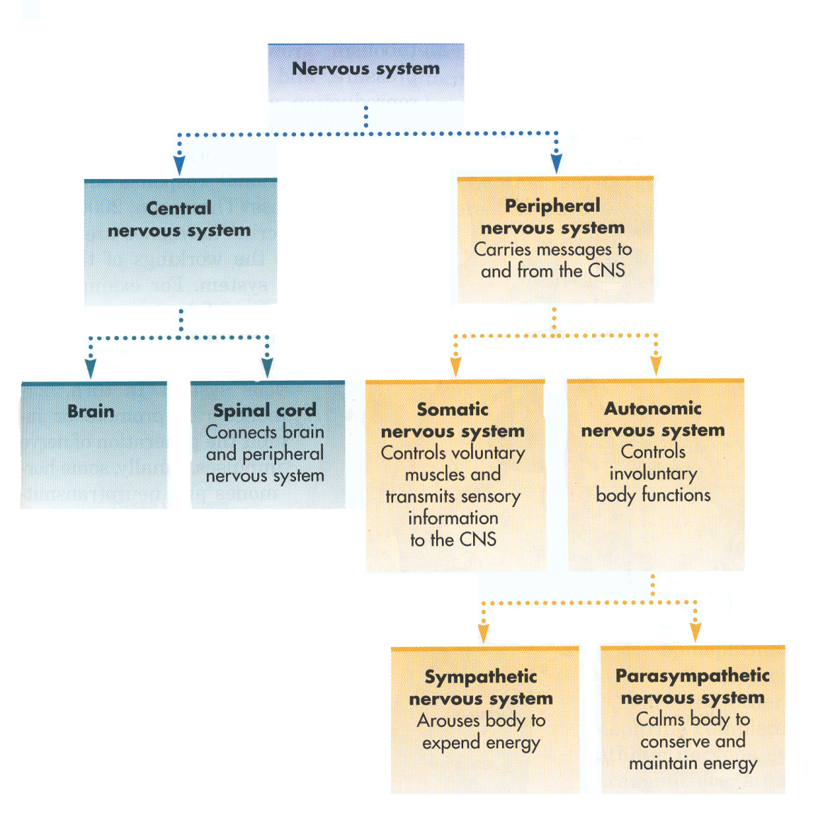
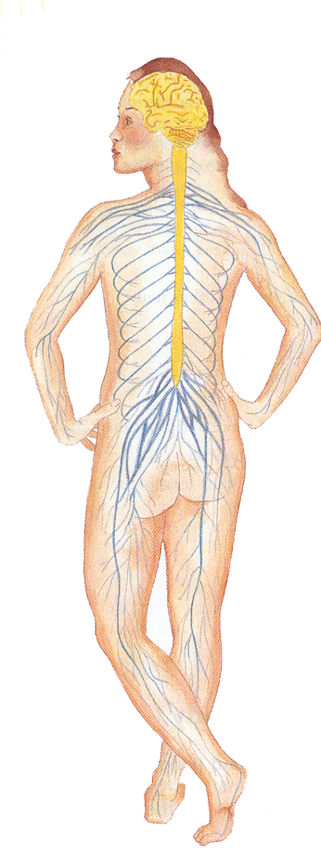

Slide 3
Function of the Nervous System?
Two main parts of the nervous system?

Slide 4
The Central Nervous System
Central Nervous System- Define
Parts- 1)
2)
Spinal Cord- Define
  Spinal Column- Define
  Spinal Reflexes- Define
    Example

Slide 5
The Peripheral Nervous System
Peripheral Nervous System- Define
  Sensory Nerves- Define
  Motor Nerves- Define

Slide 6
Divided into 2 Parts-1)Name, Define and Example
2)Name, Define, and Example
        Divided into 2 Parts-1) Name and Define
2) Name and Define
      How do they work together?

Slide 7
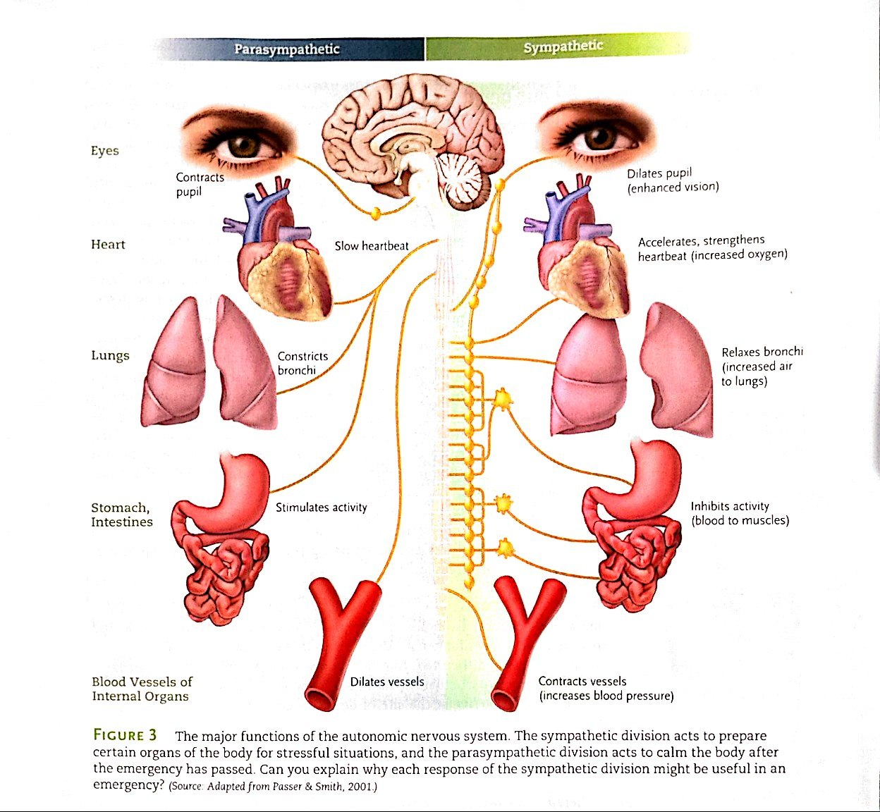

Slide 9
Communication in the Nervous System

Slide 10
Neuron- Def
Glia- Def
Neurons often called?
Estimated amount of neurons?

Slide 11
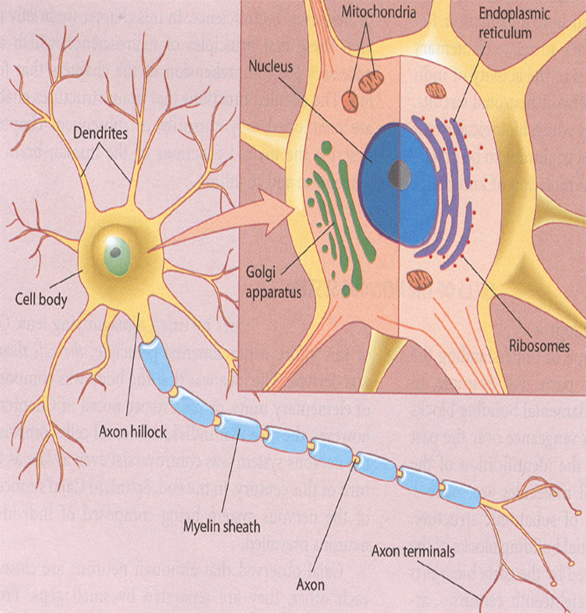
The Structure of the Neuron

Slide 12
The Structure of the Neuron
3 main parts?
Dendrites- Def
Cell Body-Def
Axon- Def
  Axon Terminals-Def
Neurons 2 jobs?
Myelin Sheath
  2 jobs?
Nerves- Def

Slide 13
The Structure of the Neuron

Slide 14
Neurons in the News
Regeneration- Explain
Do mammals produce new CNS cells?
Stem Cells- Def
  What can promote the production of new cells?
  What can hurt?
  Debate on Stem Cell Research?
    Besides embryo’s where do they get stem cells?

Slide 15
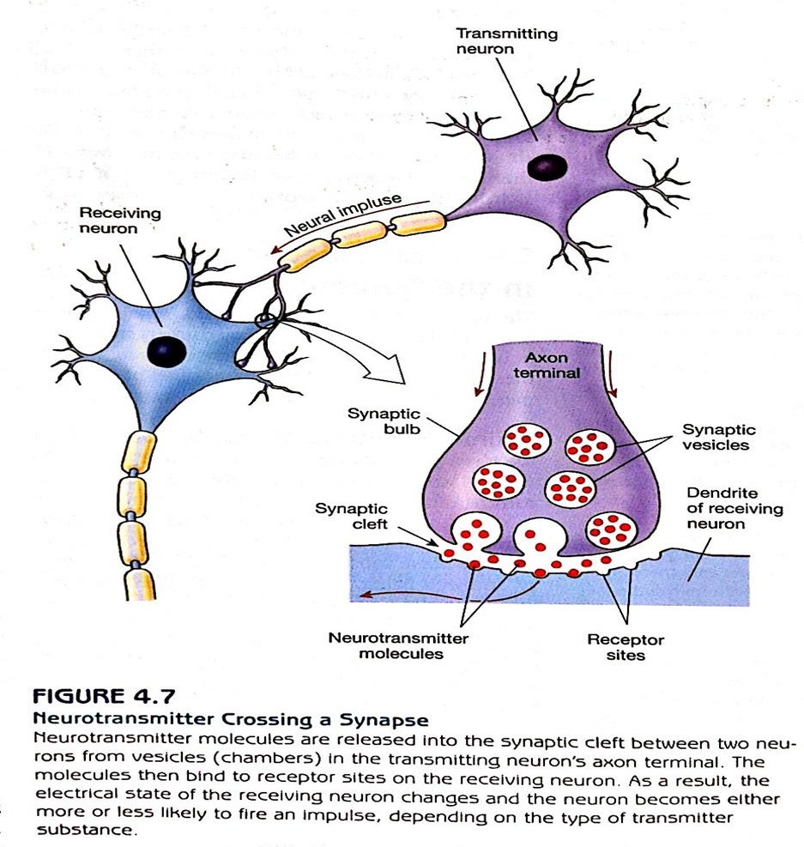
How Neurons Communicate

Slide 16
How Neurons Communicate
Synaptic Cleft- def
Synapse- Def
  When do they form?
  What should a parent do to help?
  How long does forming and pruning last?
Plasticity- Def
Action Potential- Def
  Explain unmyelinated-
    Example
  Explain myelinated-

Slide 17
How Neurons Communicate
Synaptic Vessels- Def
  Explain
Neurotransmitter- Def
Receptor Sites- Def
  Effects
    Excitatory- Def and Explain
    Inhibitory- Def and Explain

Slide 18
How Neurons Communicate

Slide 19
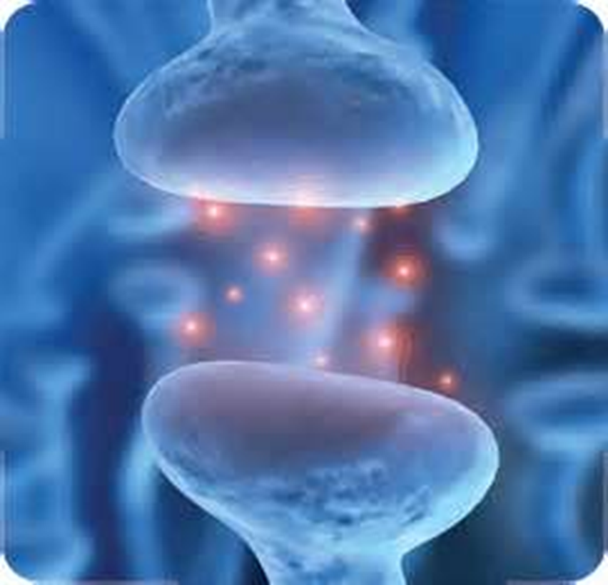

Slide 20
Chemical Messengers in the Nervous System
1) Neurotransmitters: Versatile Couriers
  Where do they exist?
  What can they affect?
  More well known neurotransmitters:
    Serotonin-Explain
    Dopamine- Explain
    Acetylcholine- Explain
    Norepinephrine- Explain
    GABA- Explain
    Glutamate
  Name 3 problems that can occur and why?
  What do they warn you about? Why?

Slide 21
2) Endorphins: The Brains Natural Opiates
  Endorphins- Def
  What roles do they Play?
  Who discovered them?
  When do endorphins “shoot up?”
  What does this give animals? Give examples?

Slide 22
3) Hormones: Long-Distance Messangers
  Hormones- Def
  Endocrine Glands- Def
  How do they work?
  Examples of Hormones
    a) Melatonin- Explain
    b) Adrenal Hormones- Explain
      Cortisol- Explain
      Epinephrine- Explain
      Norepinephrine- Explain
        How can it improve memory? Give Example

Slide 23
    c) Sex Hormones- Explain
      Androgens- Explain
      Estrogens- Explain
      Progesterone- Explane

